Slide 1
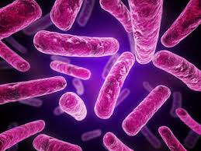
Welcome to The World of Bacteria!
Ms. Early
Rm 113
Covenant Academy ’15

Slide 2
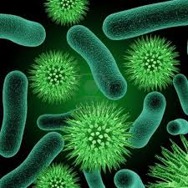
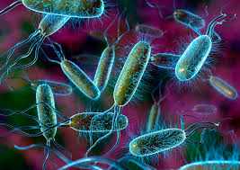
Module 2 Summary
History of the Microscope/Discovery of Bacteria
Bacteria-
Classification: Kingdom Monera
Size and Shape
Cell Structure and Function
Eating Habits
Asexual Reproduction
Genetic Recombination
Colonies
Transformation and Conduction
Gram + and Gram –
Conditions for Growth
Culturing
Infections

Slide 3
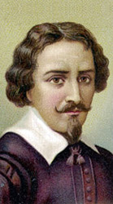
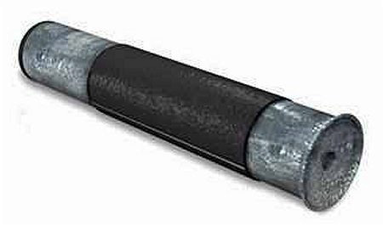
History of the Microscope
The first microscope was invented in 1590 by
two Dutch spectacle makers, Zacharias and
Hans Jansen. (Romans and Italians had
already been working on magnification)
Image was blurry, but of a significant magnification for that day
Compound microscopes feature two or more lenses, connected by
a hollow cylinder (tube). The top lens, the one people look through, is
called the eyepiece. The bottom lens is known as the objective lens.
The primary image (objective lens) is further magnified by the
secondary image(eyepiece)
Two Stage Magnification
https://www.youtube.com/watch?v=4HXKTLlEUFw
http://www.history-of-the-microscope.org/history-
of-the-microscope-who-invented-the-microscope.php

Slide 4
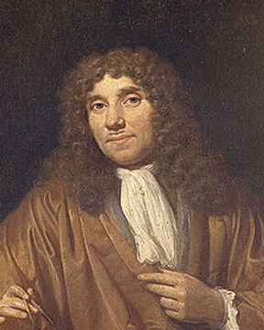
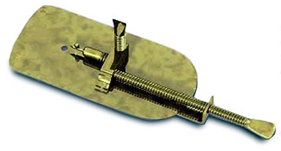
History of the MiCROSCOPE
The first man to make AND use a real microscope was Dutch
scientist named Anton van Leeuwenhoek (1632-1723)
Leeuwenhoek invented the most powerful single lens
microscope to date!
Superior magnification and Superior Lens
First to discover bacteria, yeast plants, and circulation of
blood cells in capillaries.
Reported findings to Royal Society in London and gained
membership.
https://www.youtube.com/watch?v=_D5Gu_9hEus

Slide 5
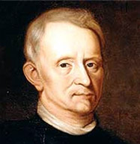
History of the MiCroscope
Van Leewenhoek's work was verified and further developed by English scientist Robert Hooke(1635-1703)
Member of Royal Society in London
Hooke advanced the biological science of microbiology
Micrographia (1665)
-first written work of microscopic studies
Cork cells discovered in 1665
Significant Observations made of Fleas

Slide 6
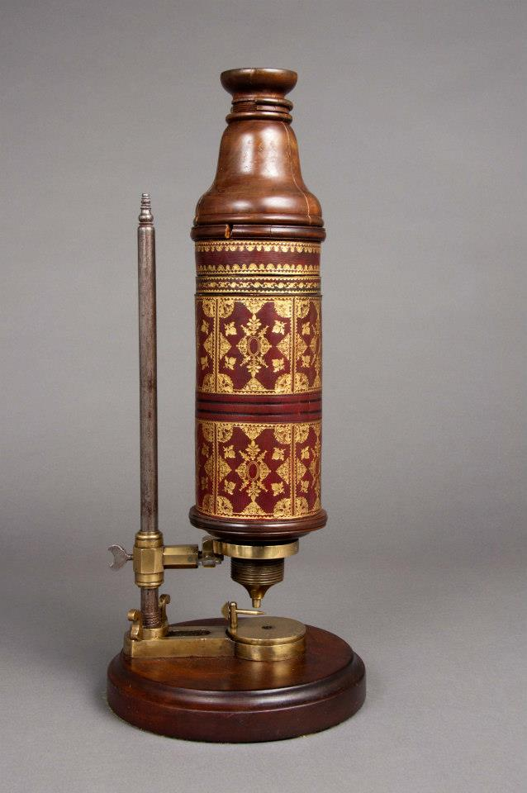
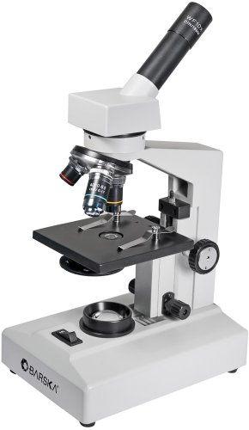
Hooke’s Microscope Current Microscope

Slide 7
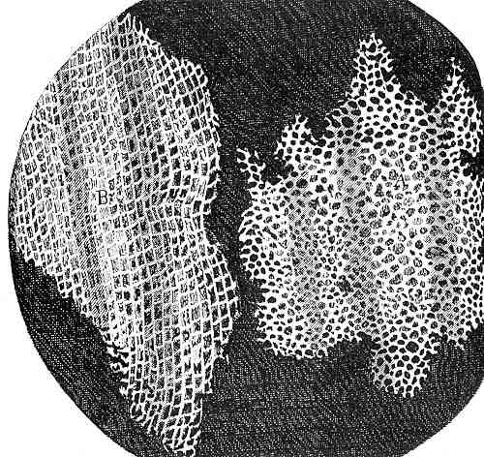
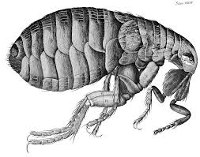
Cork Cells
The Flea

Slide 8
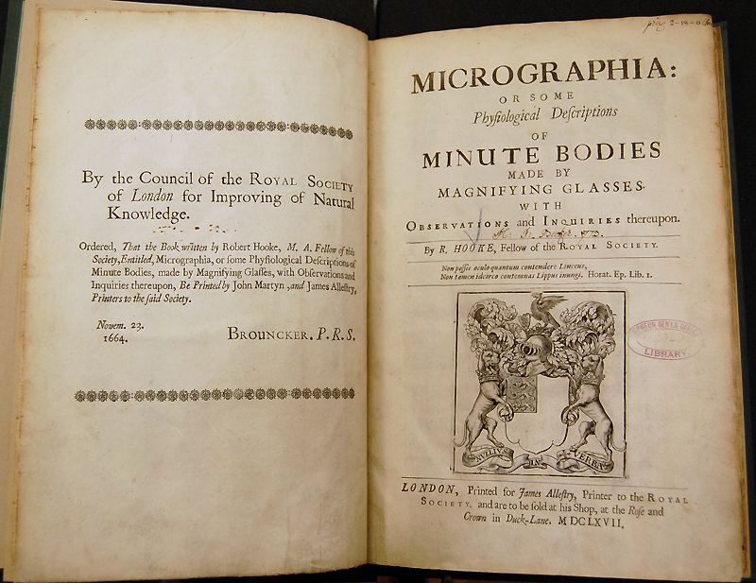
https://www.youtube.com/watch?v=pWk0cNAnC0c

Slide 9
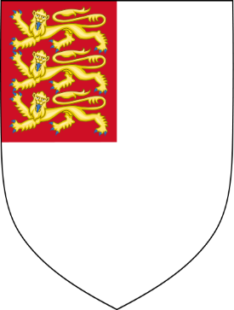
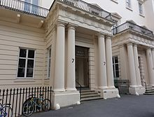
Royal SOCIETY in LOnDON
Founded: Granted Royal Charter by King Charles II in 1660
Current Location: Carrolton House Terrace London, England
Motto: Nullius in Verba (Take nobody’s word for it)
Story behind Motto: Adopted to signify the fellows' determination to establish facts via experiments and comes from Horace's Epistles, where he compares himself to a gladiator who, having retired, is free from control.

Slide 10
Name the Scientist who Discovered Bacteria

Slide 11
Bacteria Classification- KinGdom Monera
Amazing Facts About Microorganisms
- the combined weight of all microscopic organisms far exceeds
the combined weight of all other living organisms on earth!
- the number of organisms in this kingdom that live in your body
exceeds the number of cells that make up your body!
- bacteria represent the “simplest” form of life on earth!
made up of Prokaryotic Cells
can live in extreme conditions (nuclear reactors, high and low temperatures, presence of radiation, high and low acidity)

Slide 12
Good Vs. Bad Bacteria
Pathogen – An organism that causes disease
Pathogenic Bacterium- Bacterium that causes disease
example: the plague, leprosy, tuberculosis, pneumonia,
meningitis, legionnaire’s disease, typhoid fever, cholera,
lyme’s disease
Non Pathogenic Bacterium- Bacterium that do not cause
disease. example: bacteria that helps make cheese,
bacteria in your cells that help synthesize vitamins, bacteria
that act as decomposers, bacteria that uses photosynthesis
to make oxygen.

Slide 13
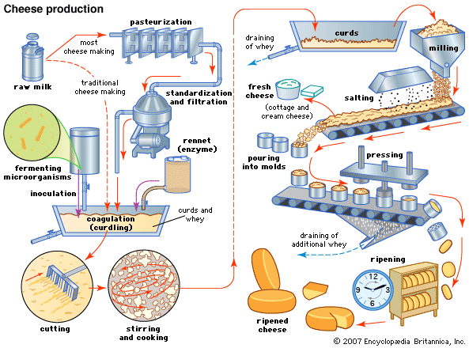
How Does Bacteria Make Cheese?
https://www.youtube.com/watch?v=y9wLhRrj5Ug
https://www.youtube.com/watch?v=9BZEy6dSY6Q

Slide 14
How Does Bacteria Make Cheese?
1) Milk is Pasteurized to get rid of “Bad Bacteria”
2)“Good Bacteria” is mixed with Milk to convert the
milk sugar into lactic acid.
3) Rennet is added to modify the milk protein
(preserve the protein)
4) “Good Bacteria” and “Rennet” cause the milk to
curdle (solids, fats, proteins from the milk)
5) Curds are soaked into Lactic Acid until “just right”
6) Water or “Whey” is separated from Lactic Acid
7) Curds are milled, salt is added and cheese is pressed

Slide 15
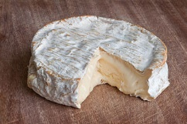
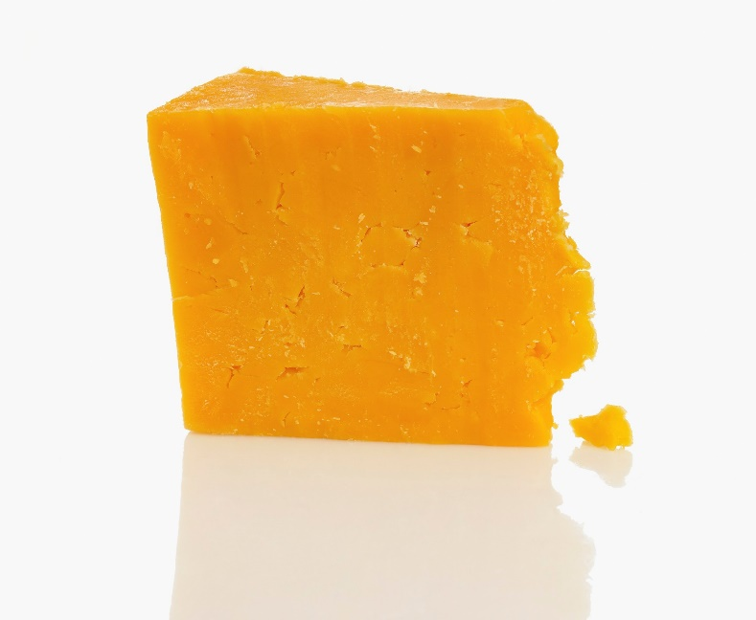
How Does Bacteria Make Cheese?
Lactobacillus helveticus produces
Mozzarella and Provolone
Lactococcus lactis produces Cheddar
Cheese made from human bacteria!
https://www.youtube.com/watch?v=MreLM0KEO28

Slide 16
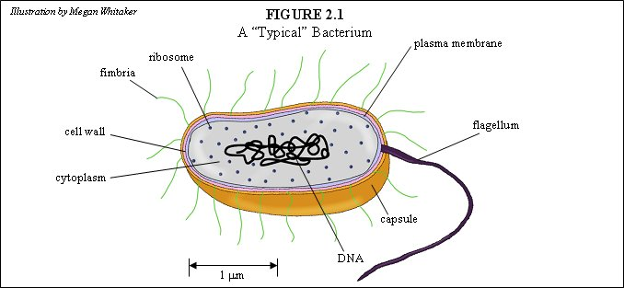
Bacterium CELL

Slide 17
Parts of the Bacterium Cell
fibrous bristles called fimbriae (fim' bree ay) (singular is fimbria). Although these might look like legs or paddles, they are not used to move the bacterium about. Instead, fimbriae are typically used for grasping. Either they grasp surfaces to help the bacteria adhere to them (as an aid to the sticky capsule), or they grasp other bacteria as a part of reproduction. If they are used in reproduction, they are called sex pili.
Cell Wall- holds the contents of the bacterium together, regulates the amount of water that a bacterium can absorb, and holds the cell into one of three basic shapes.
Plasma Membrane- located underneath the bacterium's cell wall. this membrane is made up of certain chemicals called phospholipids and other chemicals called proteins. these chemicals regulate what the bacterium takes in from the outside world.
Cytoplasm- semi-fluid substance that exists throughout the interior of the cell, supporting the DNA and the ribosomes.
Fimbriae- fibrous bristles used for grasping surfaces to help bacteria adhere to them. (as an aid to the sticky capsule) when used to grasp
other bacteria as part of reproduction, they are called sex pili.

Slide 18
Parts of the Bacterium Cell
Ribosome- chemical factories. make special chemicals known as proteins. (a lot more on ribosomes later!)
DNA- holds all of the information required to make this mass of chemicals a living entity.
Capsule- surrounds the cell wall. composed of an organized layer of sticky sugars that help the bacteria adhere to surfaces. (example- the bacteria that cause tooth decay are able to cling to teeth using their sticky capsules.)the capsule is the bacterium's protective layer which tends to deter infection-fighting agents.

Slide 19
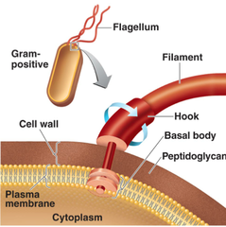
Parts of the Bacterium Cell
Flagella- accomplishes locomotion(moving the bacterium from one
location to the other) if the cell does not have flagella, then there is
no locomotion. some bacteria have none. some bacteria have more
than one.
It is composed of three parts:
a)Filament- attaches to the hook
b)Hook- The hook slides onto a rod that sticks
through the cell wall.
c)Basal Body- the rod, and all of the structures
that attach it to the cell wall.

Slide 20
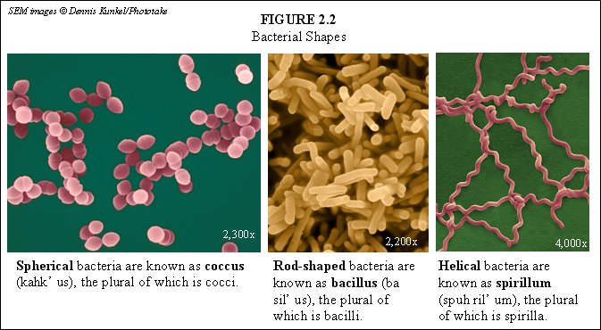
3 Types of Bacteria

Slide 21
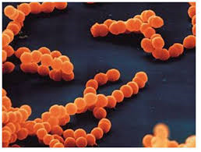
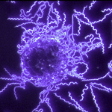
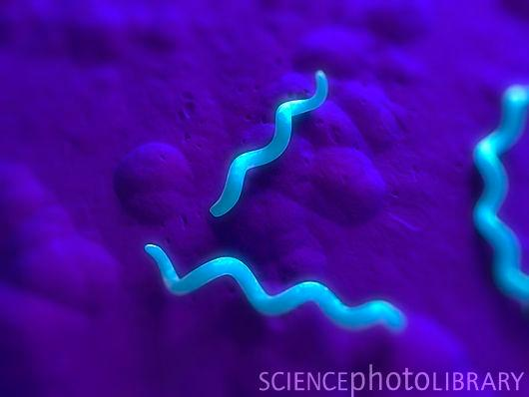
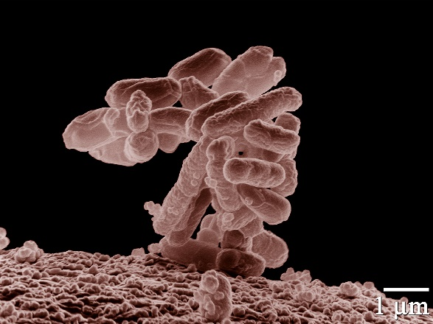
Name the Bacteria Shape of the Following:
Lactobacillus helveticus Strepococcal pharyngitis
Staphylococcus aureus
Borrelia burgdorferi
Spirillum volutans Escherichia coli

Slide 22
OYO Questions
Two different species of bacteria attempt to infect an organism. One bacterium succeeds, while the other is destroyed by the organism's infection-fighting mechanisms. What is most likely the major difference between these two bacteria?
A bacterium is poisoned by a substance that is allowed into the interior of the cell. What bacterial component did not do its job?
If a bacterium cannot move, what structure is it missing?

Slide 23
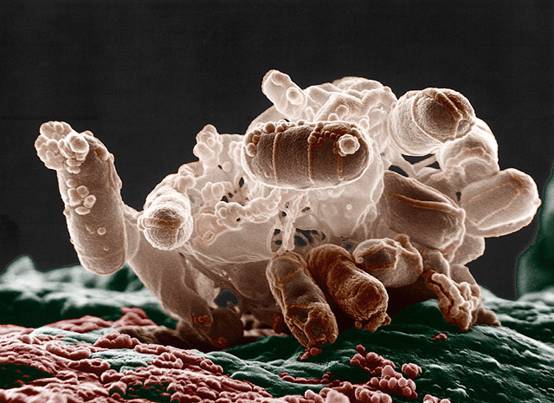
Bacteria
E. COLI
Flesh Eating Bacteria
Staph
Salmonella
Typhoid Fever (Mary)
Case Study Involving one of these

